Slide 1



AI Workshop 1: Introduction to AI (Online) Saturday 15th February 2025
Omar Choudhry

Slide 2

About Me
Graduated with a BSc in Computer Science with Artificial Intelligence
Completed an integrated MSc in Artificial Intelligence for Medical Diagnosis and Care
Currently studying a PhD in AI for Healthcare, using AI to train laparoscopic surgeons, specifically in low-and-middle-income countries
President of the AI Society
Postgraduate Teaching Assistant
Postgraduate Representative for the School of Computer Science
Former School and Course Representative for the School of Computer Science
Education Outreach Fellow for the Faculty of Engineering and Physical Sciences
Notes:
2 minutes
Briefly explain what students will achieve: Understand AI basics, image recognition, and how to train an AI model.

Slide 3
Learning Objectives
By the end of this lesson, you will learn:
What is AI and how does it work?
What is machine learning?
How can we train an AI model?
What are the ethical considerations of AI?
How can we use AI to solve everyday challenges?
Notes:
2 minutes
Briefly explain what students will achieve: Understand AI basics, image recognition, and how to train an AI model.

Slide 4
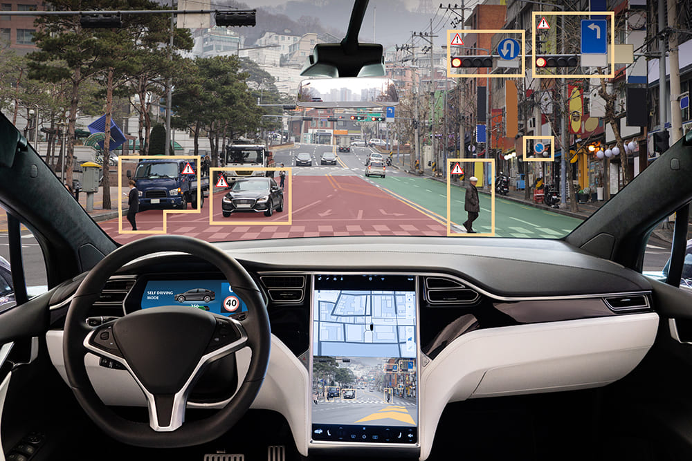
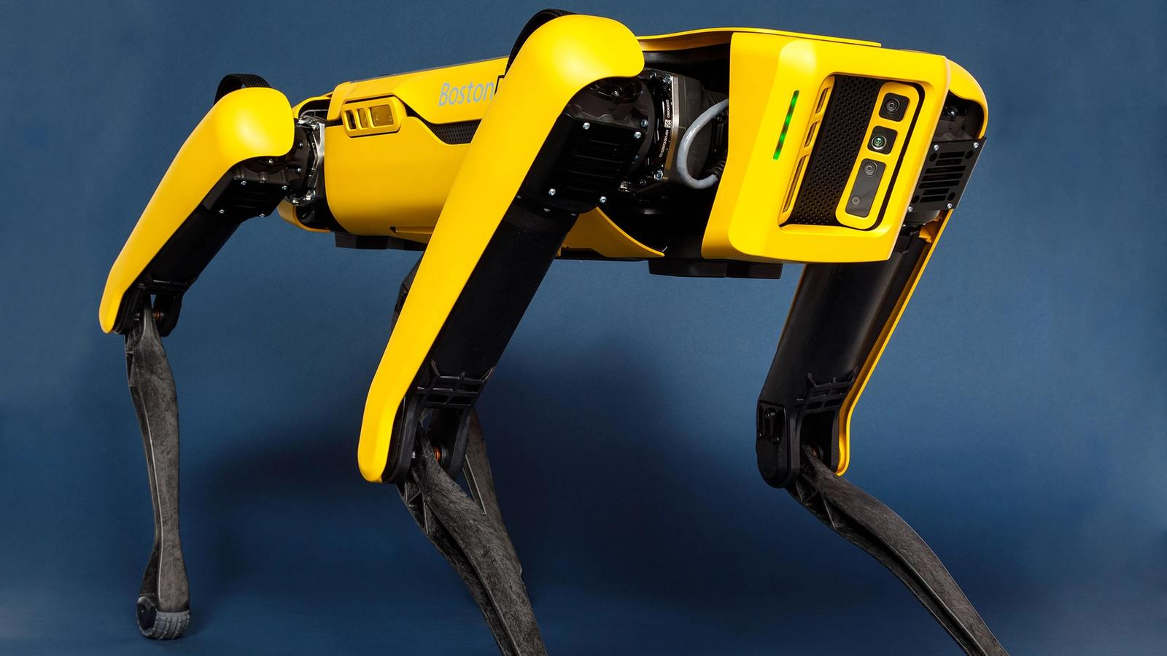
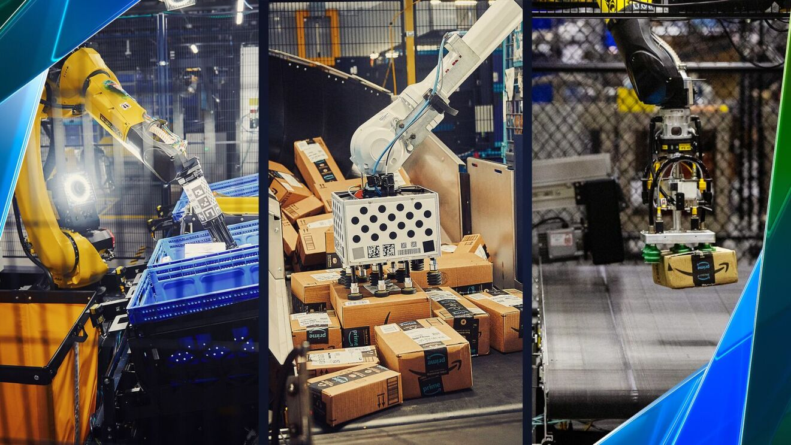

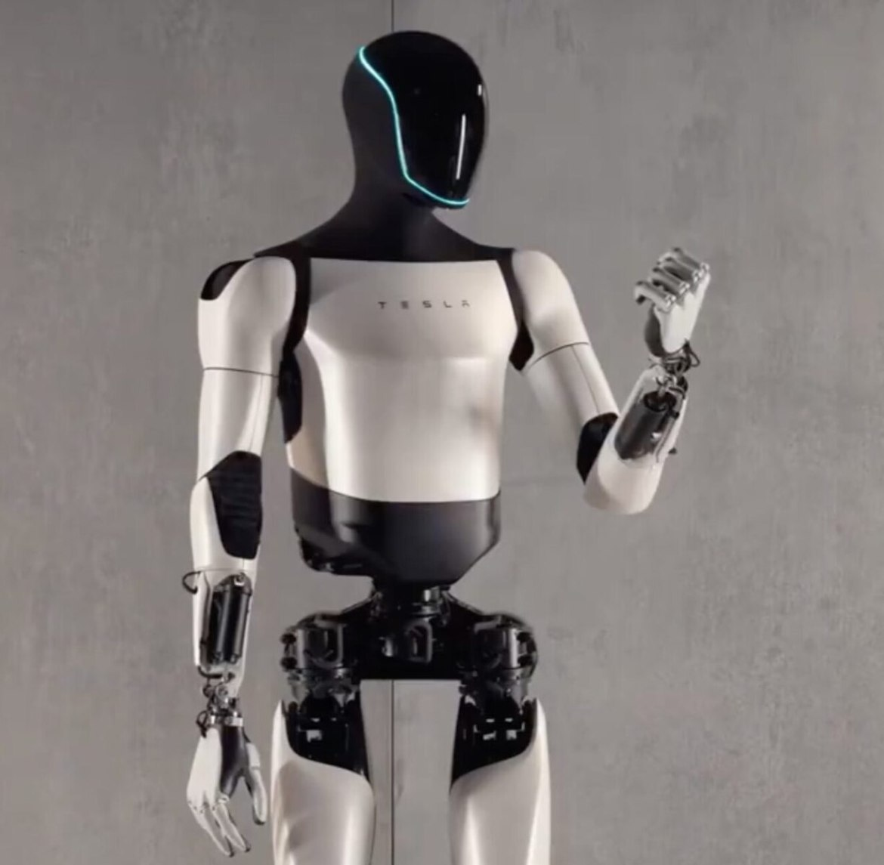
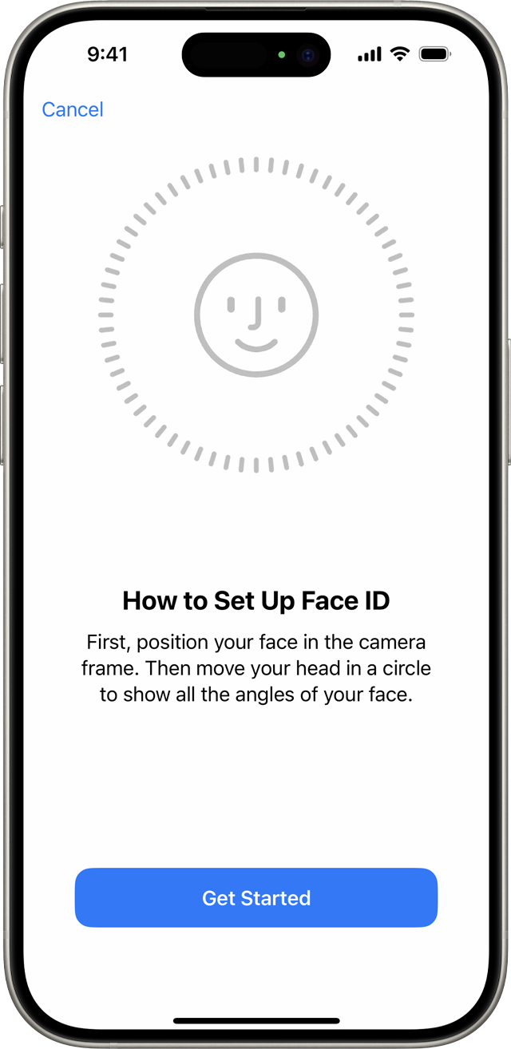
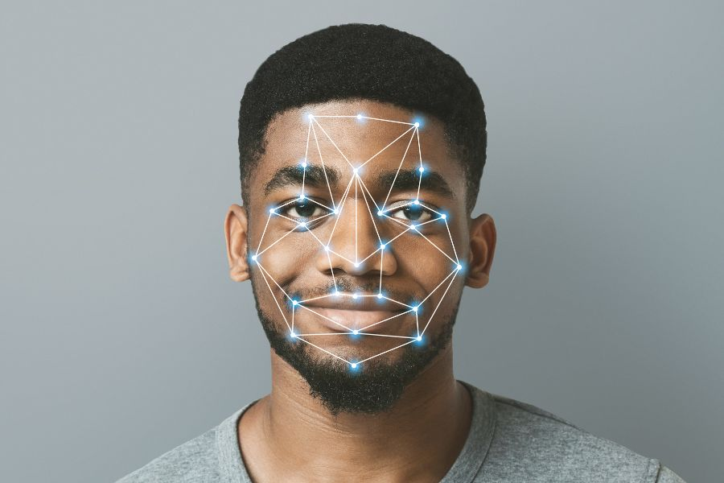
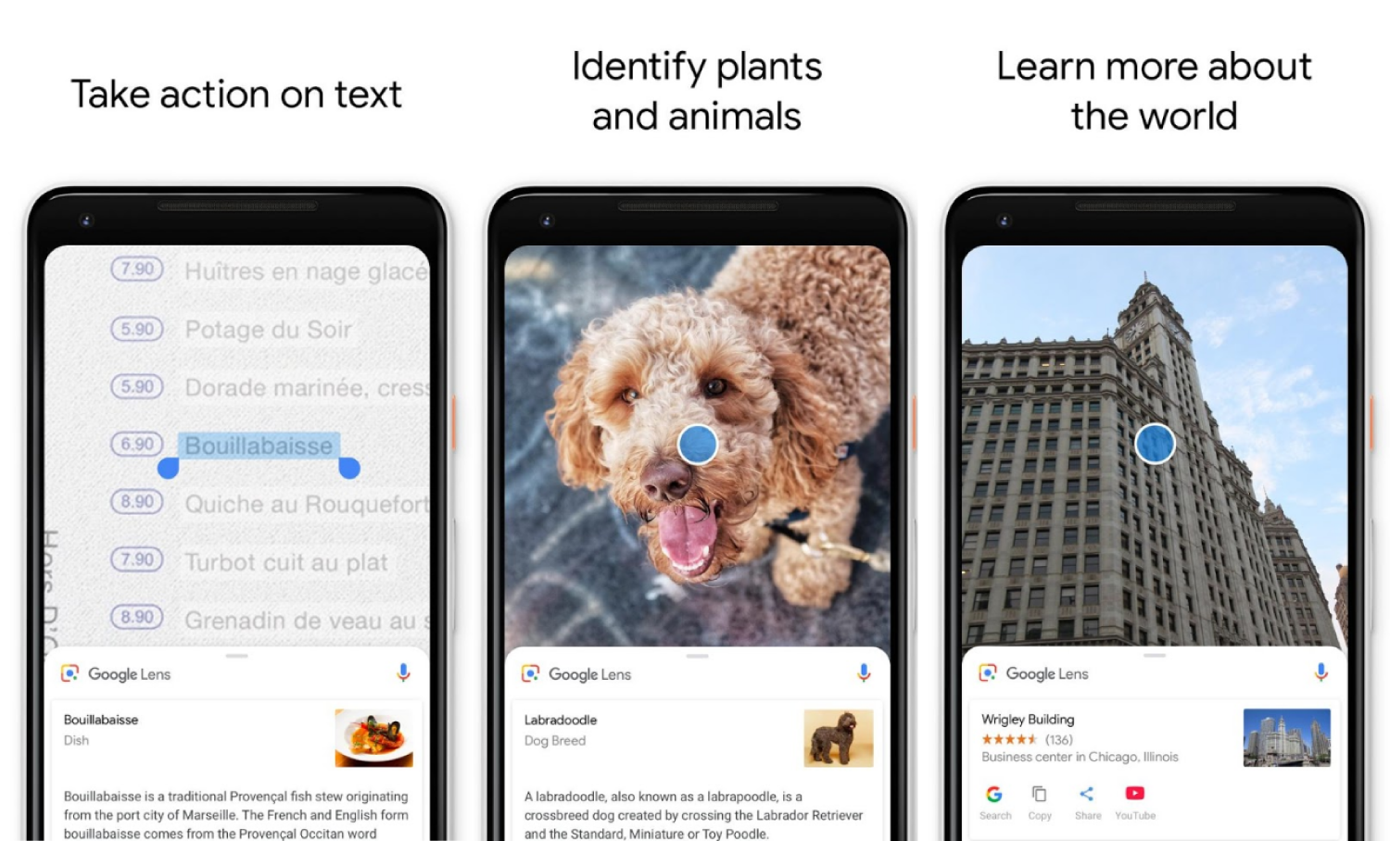

Starter Activity: AI in Everyday Life
Notes:
5 minutes
Initially start with an attention grabber, showing some really cool examples of AI applications (e.g. facial recognition, self-driving cars, voice assistants, Google Lens). Discuss where AI is used daily. Encourage students to share ideas about what data might be required and the pros and cons of different AI tools. Students will work in pairs to list all the AI-powered technologies they encounter daily and finally share findings as a group. They will also think about the question “Will AI replace humans?” to stimulate a discussion around how AI is a tool used to enhance our everyday lives and how it is not okay to AI to write your homework for you.
Objective: Highlight AI’s presence in everyday life and spark curiosity.

Slide 5
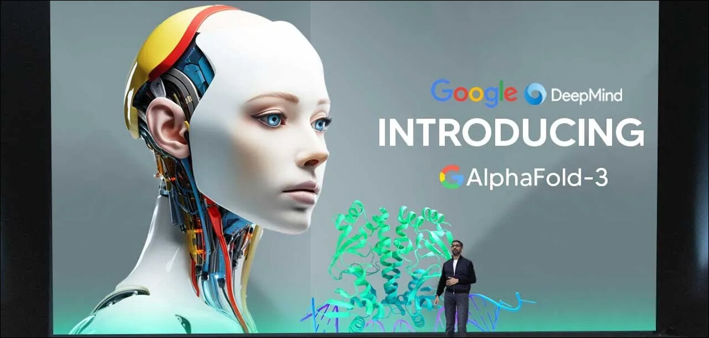
Notes:
5 minutes
Explain how AI performs different tasks using machine learning, using simple visuals and analogies. Learn about how AI uses large amounts of data to recognise patterns and make predictions.

Slide 6
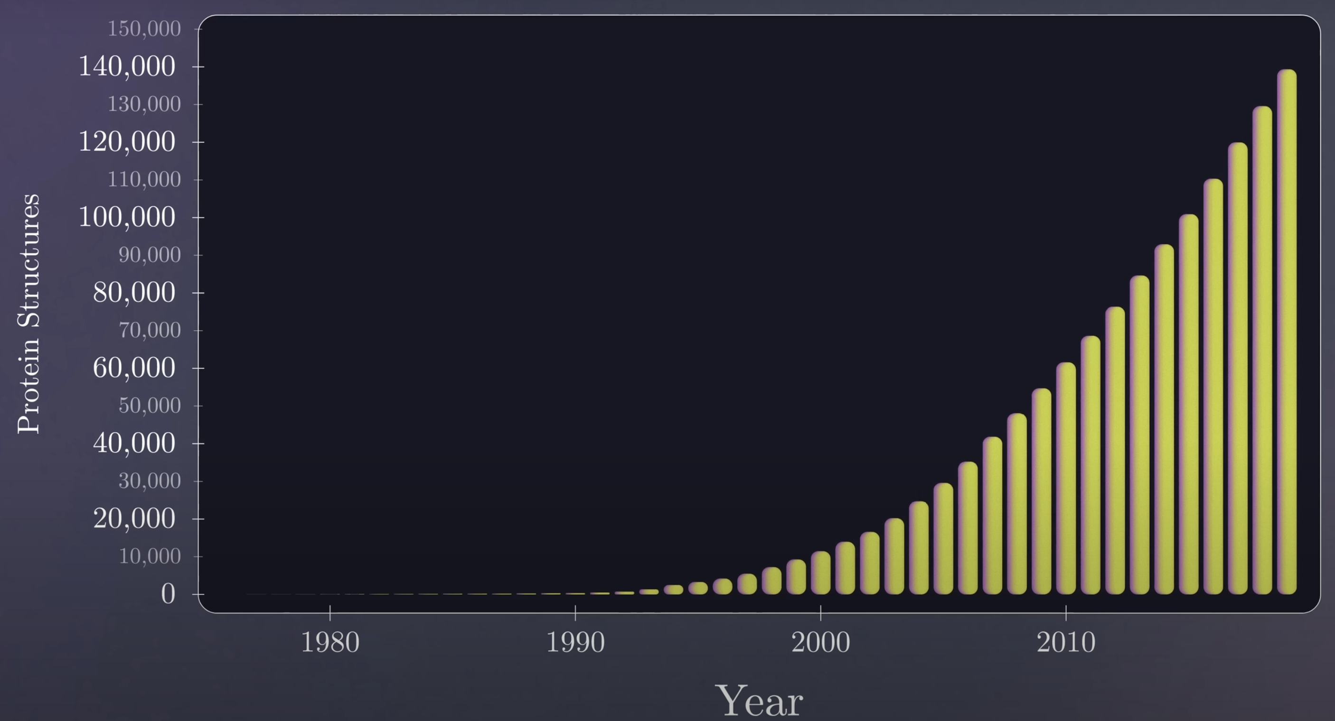
https://www.youtube.com/watch?v=P_fHJIYENdI&ab_channel=Veritasium
Notes:
5 minutes
Explain how AI performs different tasks using machine learning, using simple visuals and analogies. Learn about how AI uses large amounts of data to recognise patterns and make predictions.

Slide 7

https://www.youtube.com/watch?v=P_fHJIYENdI&ab_channel=Veritasium
Notes:
5 minutes
Explain how AI performs different tasks using machine learning, using simple visuals and analogies. Learn about how AI uses large amounts of data to recognise patterns and make predictions.

Slide 8
Starter Activity: AI in Everyday Life
Try completing the following in chat:
List other daily tools that you think use AI.
For each one, think about what data would be required and what are their pros and cons?
Will AI replace humans?
Is it okay to use AI to do your work for you?
Notes:
5 minutes
Initially start with an attention grabber, showing some really cool examples of AI applications (e.g. facial recognition, self-driving cars, voice assistants, Google Lens). Discuss where AI is used daily. Encourage students to share ideas about what data might be required and the pros and cons of different AI tools. Students will work in pairs to list all the AI-powered technologies they encounter daily and finally share findings as a group. They will also think about the question “Will AI replace humans?” to stimulate a discussion around how AI is a tool used to enhance our everyday lives and how it is not okay to AI to write your homework for you.
Objective: Highlight AI’s presence in everyday life and spark curiosity.

Slide 9

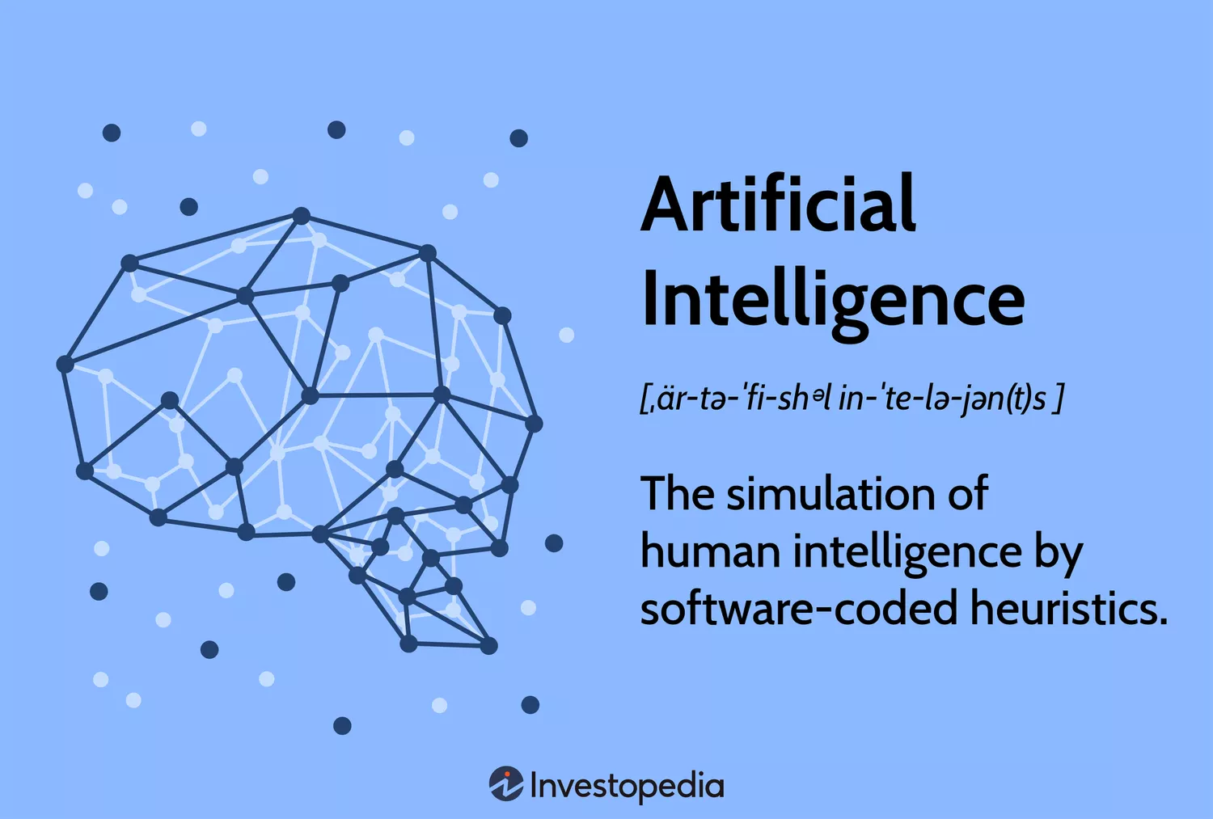
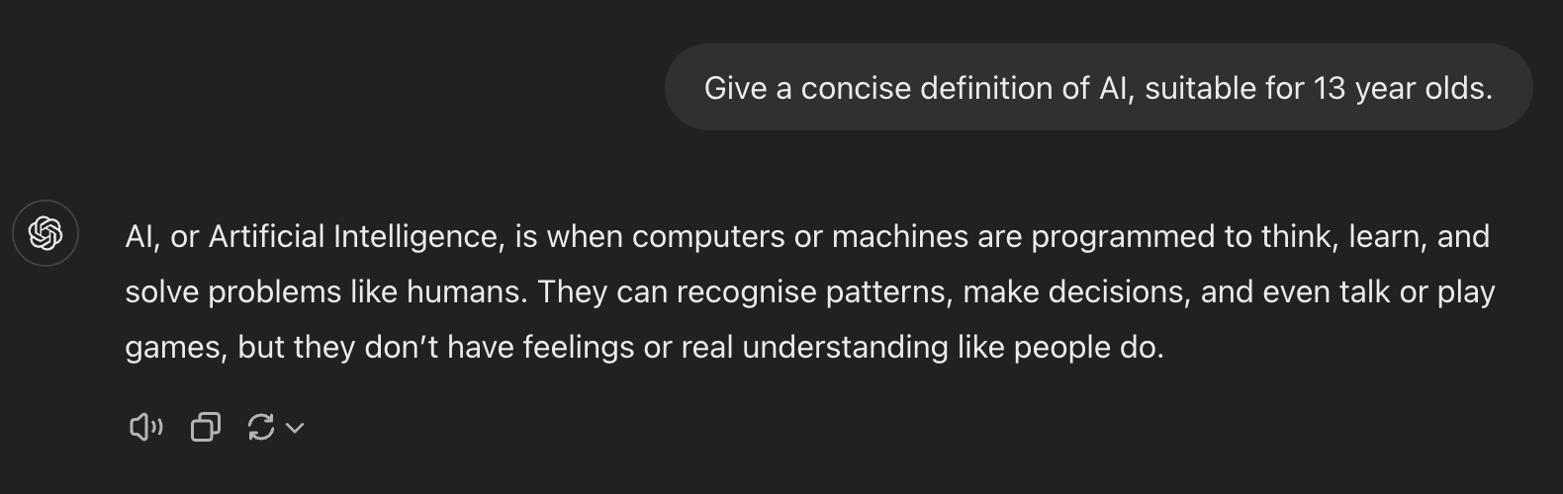
How does AI work?
Notes:
5 minutes
Explain how AI performs different tasks using machine learning, using simple visuals and analogies. Learn about how AI uses large amounts of data to recognise patterns and make predictions.

Slide 10
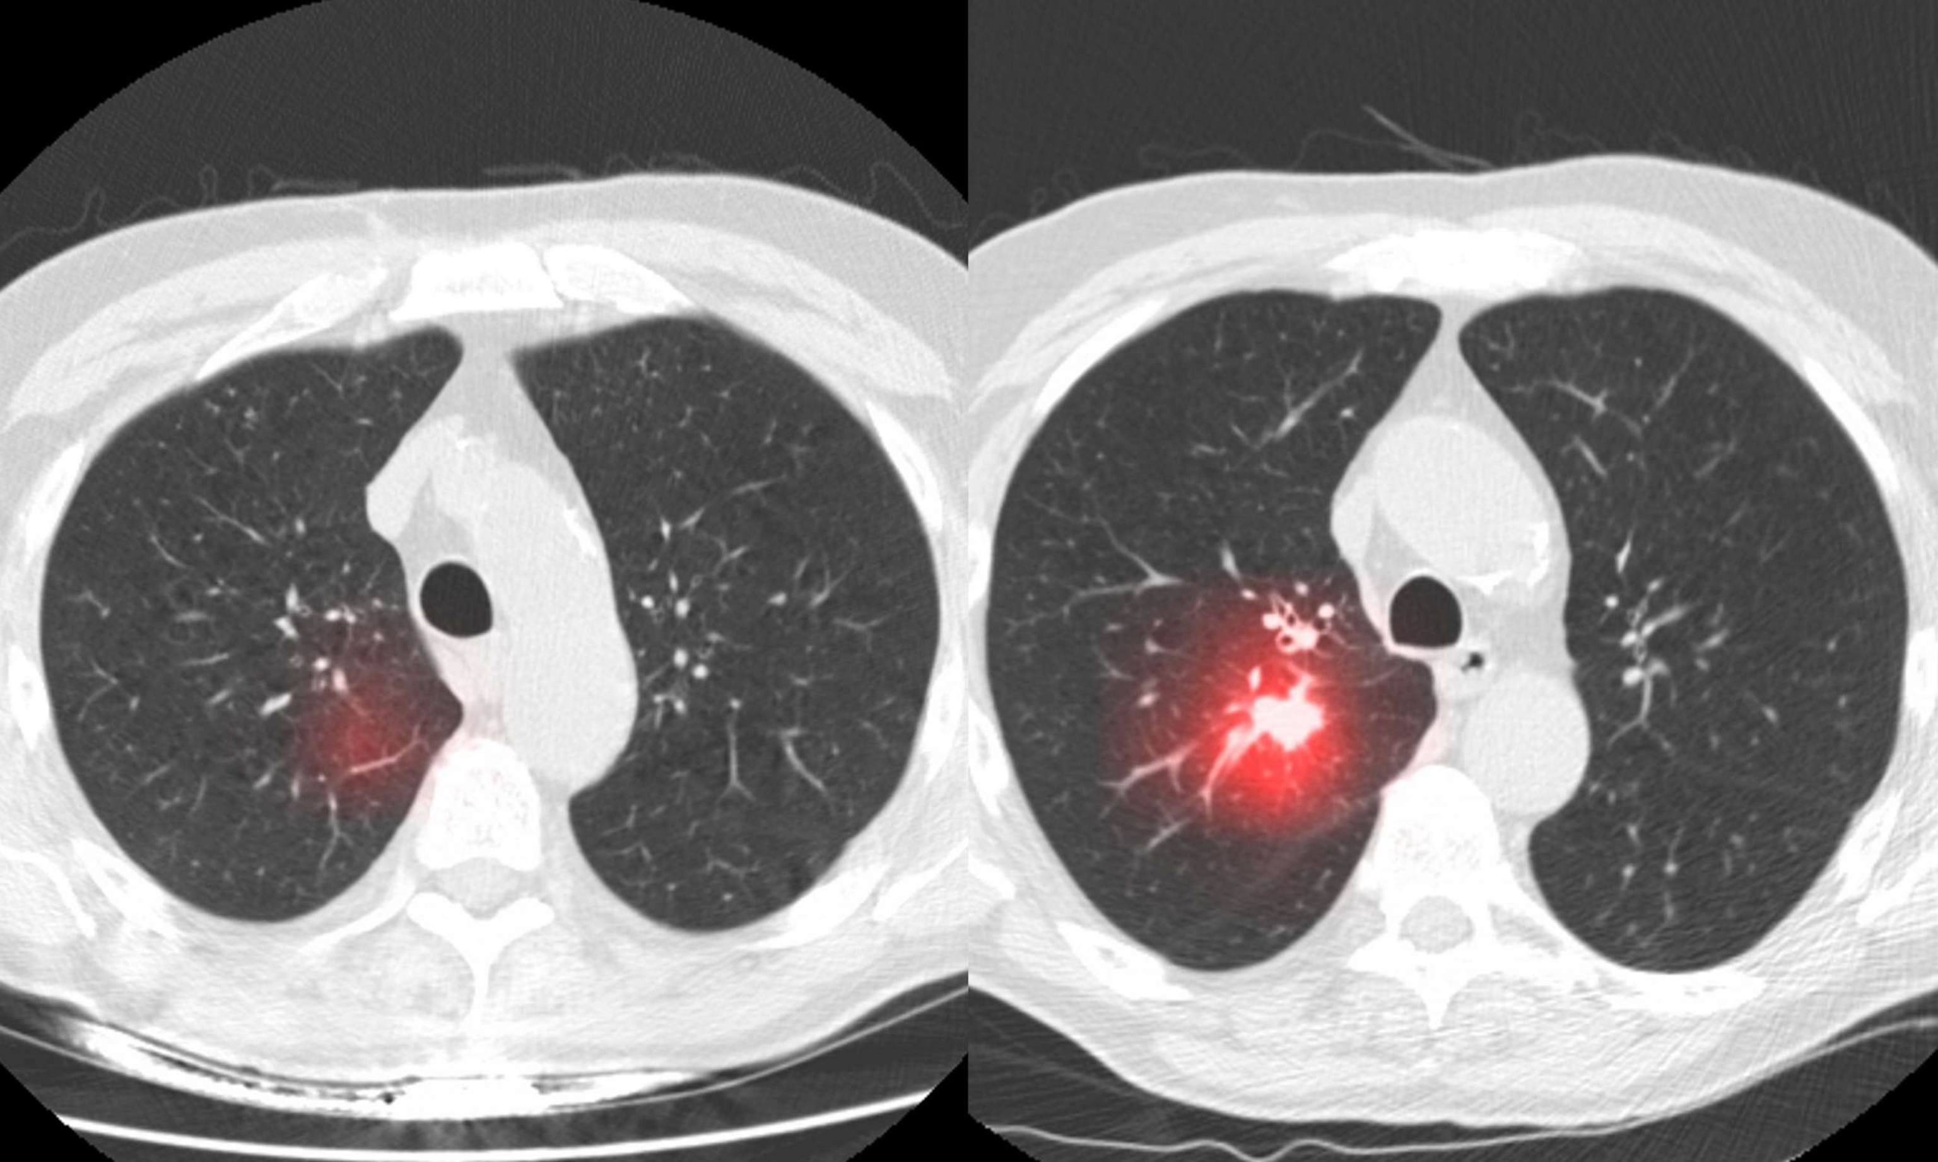
How does AI work?
Notes:
5 minutes
Explain how AI performs different tasks using machine learning, using simple visuals and analogies. Learn about how AI uses large amounts of data to recognise patterns and make predictions.

Slide 11
Basics of Machine Learning
Machine learning: algorithms which learn patterns in data to make predictions
AI will use large amounts of data (e.g. images, text, audio, etc.).
Humans will label some of this data with what we want our models to predict.
AI models try to learn* the underlying patterns of similar data (e.g. the distinct characteristics of digits which let us differentiate between numbers 1, 2, 3, 4, etc.).
When we give AI a new piece of data, it uses the patterns it learnt from the initial data (we call this training data) and guesses which option has the highest probability.
Notes:
5 minutes
Why is machine learning the foundation of image recognition? Look more technically at how models are trained using labelled data to classify or identify objects and features (e.g. edges, shapes) in images.

Slide 12



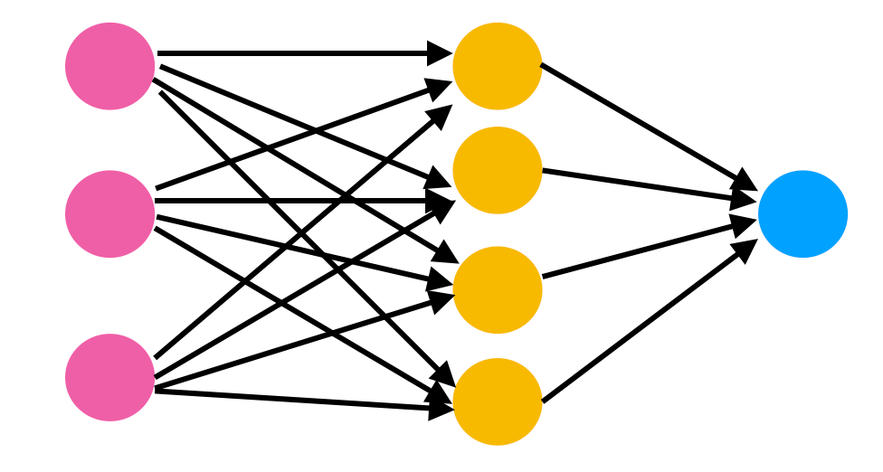
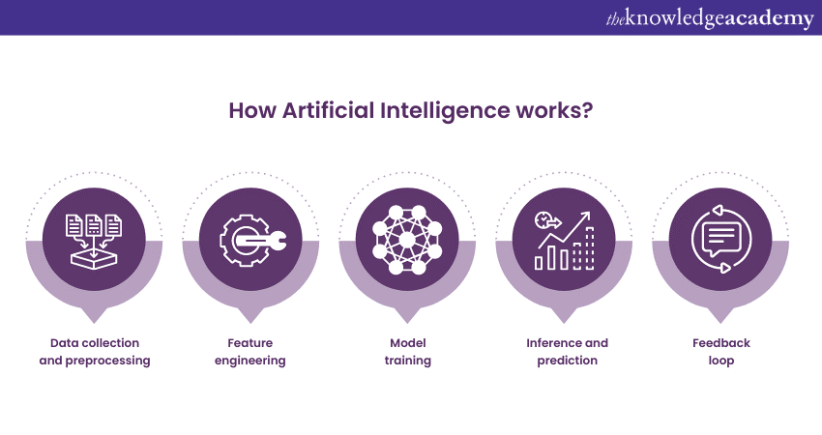
Basics of Machine Learning
Notes:
5 minutes
Why is machine learning the foundation of image recognition? Look more technically at how models are trained using labelled data to classify or identify objects and features (e.g. edges, shapes) in images.

Slide 13

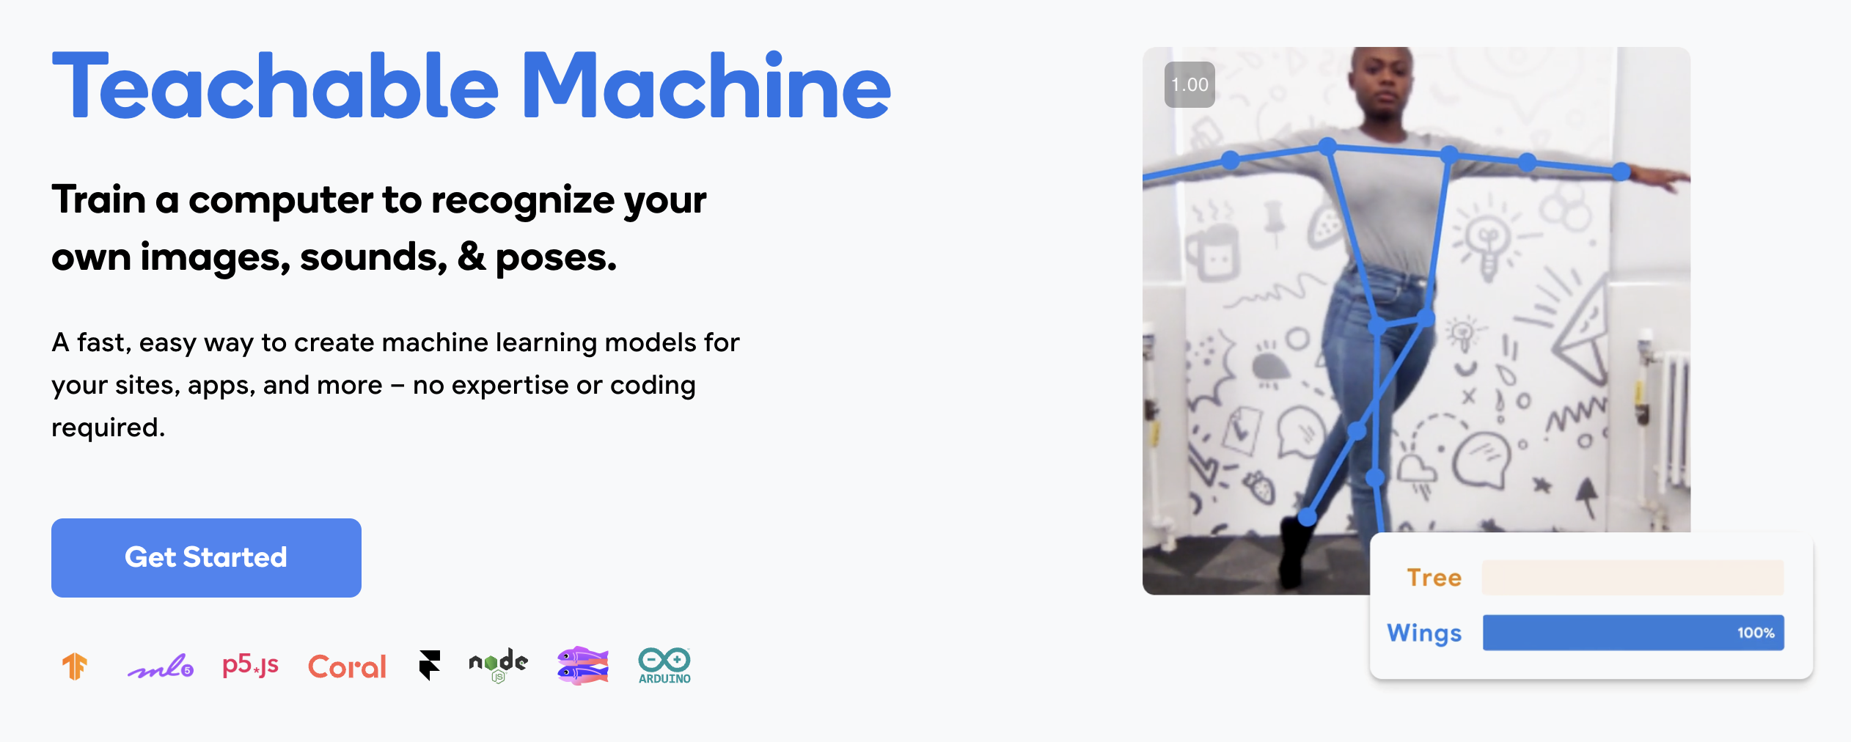
Hands-on Activity: Training an AI Model
https://teachablemachine.withgoogle.com/
Notes:
15 minutes
Use Teachable Machine. Guide students to train a model to recognise objects or images. Encourage experimenting with different inputs. In small groups, upload sample images and test the model by providing new inputs.
Objective: Provide a tangible experience of how AI learns and performs image recognition.

Slide 14
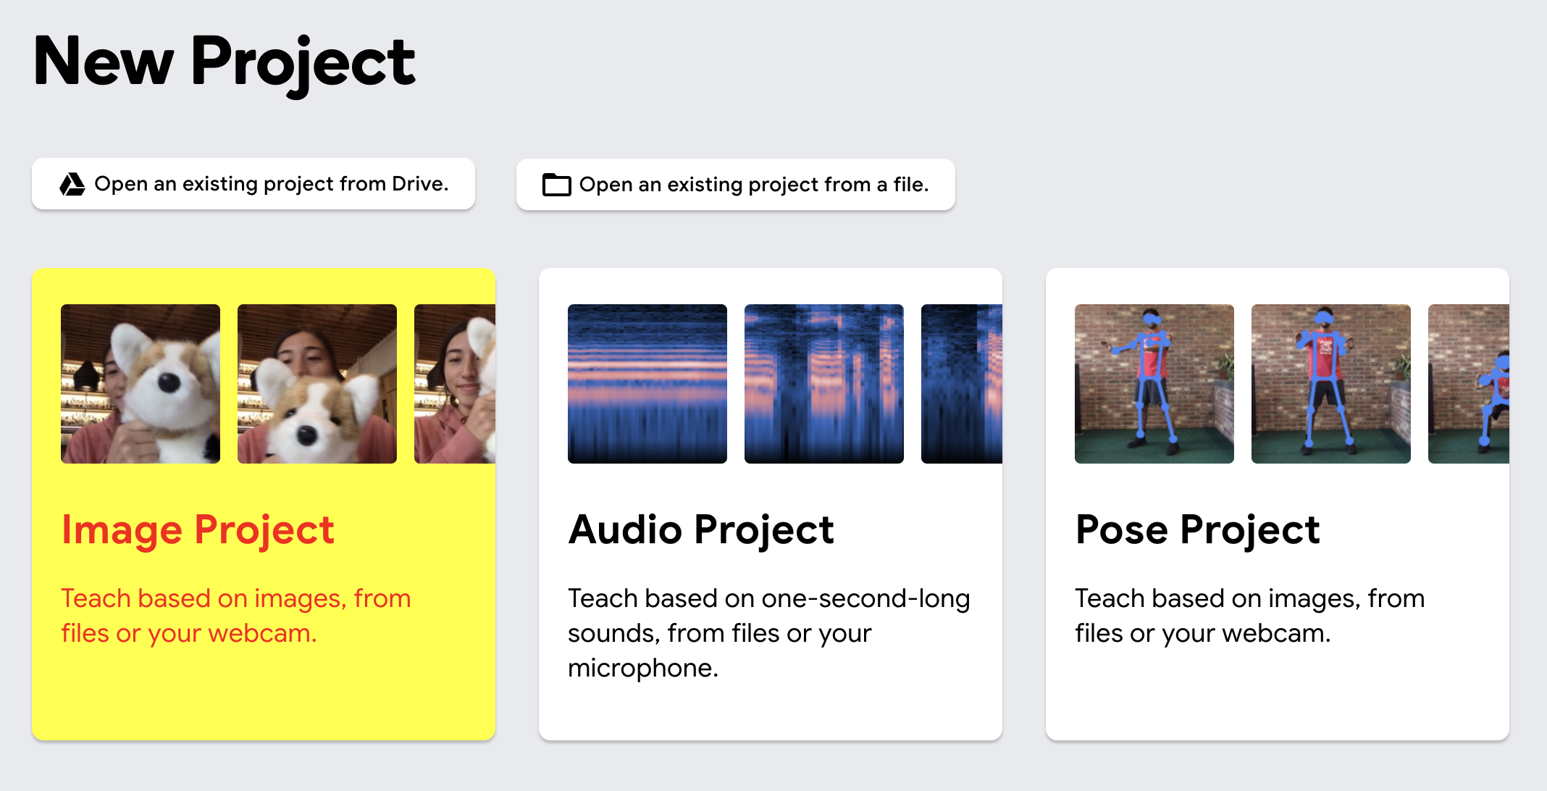

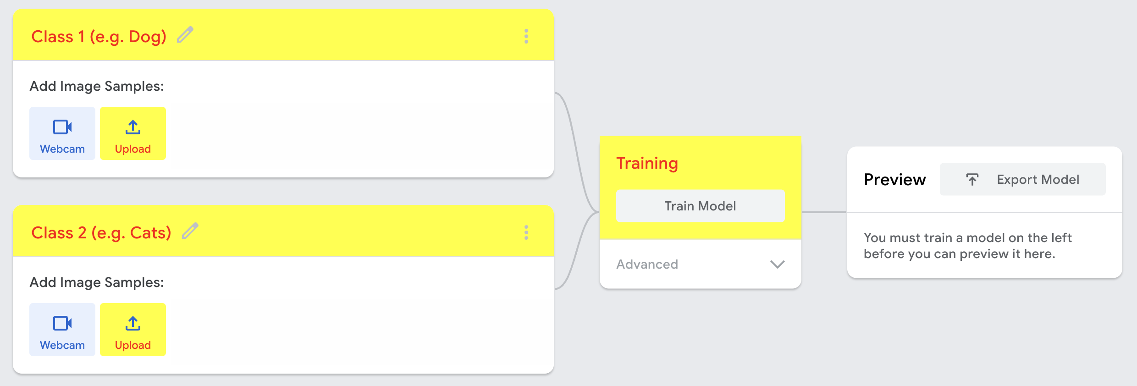

Hands-on Activity: Training an AI Model
Notes:
15 minutes
Use Teachable Machine. Guide students to train a model to recognise objects or images. Encourage experimenting with different inputs. In small groups, upload sample images and test the model by providing new inputs.
Objective: Provide a tangible experience of how AI learns and performs image recognition.

Slide 15




Hands-on Activity: Training an AI Model
“dog4.jpg”, “cat8.jpg”, etc.
“dog1.jpg”, “cat5.jpg”, etc.
Notes:
15 minutes
Use Teachable Machine. Guide students to train a model to recognise objects or images. Encourage experimenting with different inputs. In small groups, upload sample images and test the model by providing new inputs.
Objective: Provide a tangible experience of how AI learns and performs image recognition.

Slide 16
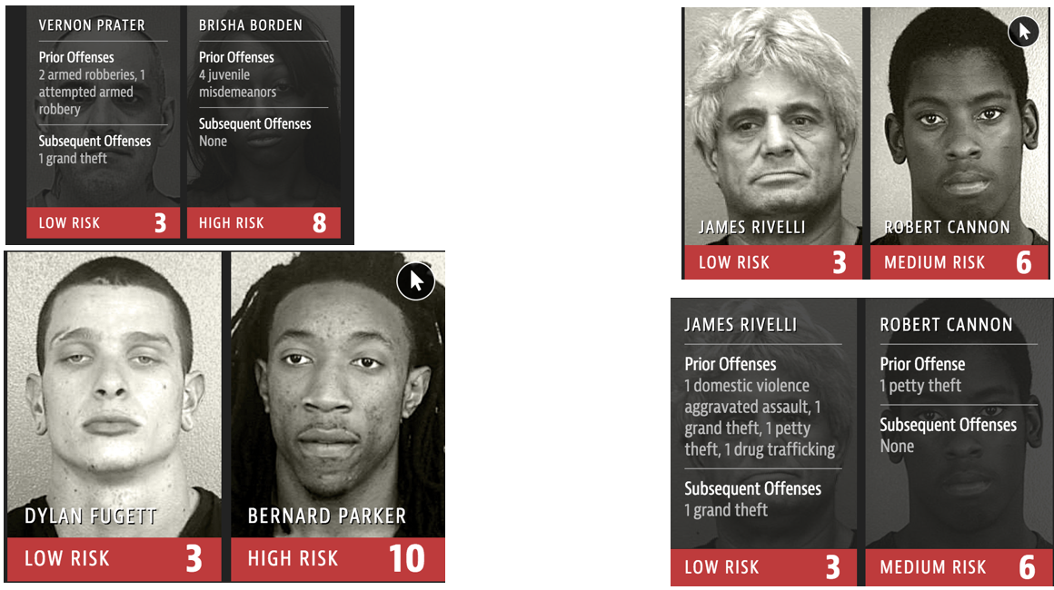
Ethical Considerations in AI
Notes:
10 minutes
AI has ethical implications, such as privacy concerns, bias in training data, and potential job displacement. Responsible AI development is critical. Discuss the real-world impact of AI in industries like healthcare, retail, and autonomous vehicles. Introduce ethical considerations briefly.

Slide 17
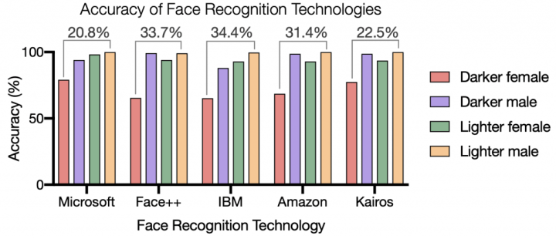
Ethical Considerations in AI
Notes:
10 minutes
AI has ethical implications, such as privacy concerns, bias in training data, and potential job displacement. Responsible AI development is critical. Discuss the real-world impact of AI in industries like healthcare, retail, and autonomous vehicles. Introduce ethical considerations briefly.

Slide 18
Ethical Considerations in AI
AI has many ethical implications.
1. potential job displacement
2. bias and discrimination
3. privacy concerns
4. black-box nature
5. trust
6. over-reliance
7. responsibility
8. warfare
Notes:
10 minutes
AI has ethical implications, such as privacy concerns, bias in training data, and potential job displacement. Responsible AI development is critical. Discuss the real-world impact of AI in industries like healthcare, retail, and autonomous vehicles. Introduce ethical considerations briefly.

Slide 19
Brainstorm – Using AI for Everyday Challenges
How AI could solve problems in your own school, workplace or community in local challenges (e.g. waste management, education).
Notes:
15 minutes
Brainstorm how AI could solve problems in their school or community in local challenges (e.g. waste management, education). Students will be guided using prompts. Each group should create a simple proposal or sketch for their AI solution and share it with the class with a single Google slide.
Objective: Foster creativity and critical thinking about AI’s potential impact.

Slide 20
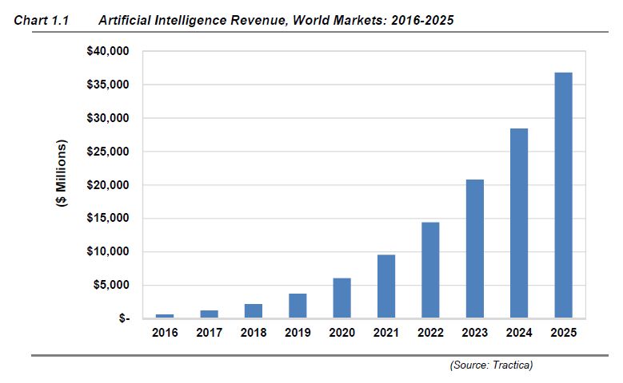
Plenary
Key Words:
Artificial Intelligence
Machine Learning
AI Ethics
AI Models
Black-box
Training & Test Sets/Data
Could you answer the following now?
What is AI and how does it work?
What is machine learning?
How can we train an AI model?
What are the ethical considerations of AI?
How can we use AI to solve everyday challenges?
Notes:
3 minutes
Recap key points: AI concepts, how image recognition works, and the potential of AI. Encourage students to explore AI further.
Key Words: Artificial Intelligence, Machine Learning, Image Recognition, Ethics in AI, Models in AI, Black box, Training set/data, Test set/data,

Slide 21



Feedback
Contact
Slides are available at github.com/omariosc/ai-workshops
O.Choudhry@leeds.ac.uk
Feedback Form
WhatsApp Community Chat

